Slide 1
QISKIT FALL FEST 2026 — SRM UNIVERSITY-AP | TRACK: OPTIMIZATION
Quantum Optimization of Network Partitioning Using QAOA
Problem PS-O1 • Hardware Co-Design Paradigm • Team VARANASI
EXECUTIVE HYPOTHESIS & SCIENTIFIC VERIFICATION
NISQ algorithms waste critical coherence on routing overhead. By co-designing Processor D to natively embed the PS-O1 interaction graph, we eliminate 100% of routing SWAPs, reducing physical CX gates by 14.3% and circuit depth by 21.6%, while delivering an optimal solution sampling probability of 12.50% (a 4.0x enhancement over uniform random guessing).
0 SWAPs
-100% Routing Overhead
18 CX Gates
-14.29% vs Generic B (21)
Depth 29
-21.62% vs Generic B (37)
4.0x Sampling
12.50% vs 3.125% Random
Team: VARANASI | Team ID: AP251100708044 | Lead: Ganesh Pirinti | Release: Phase 2 Reproducible Submission
VARANASI (AP251100708044) | PS-O1 QAOA Network Partitioning | Qiskit Fall Fest 2026 — SRM University-AP | Slide 1 of 9

Slide 2
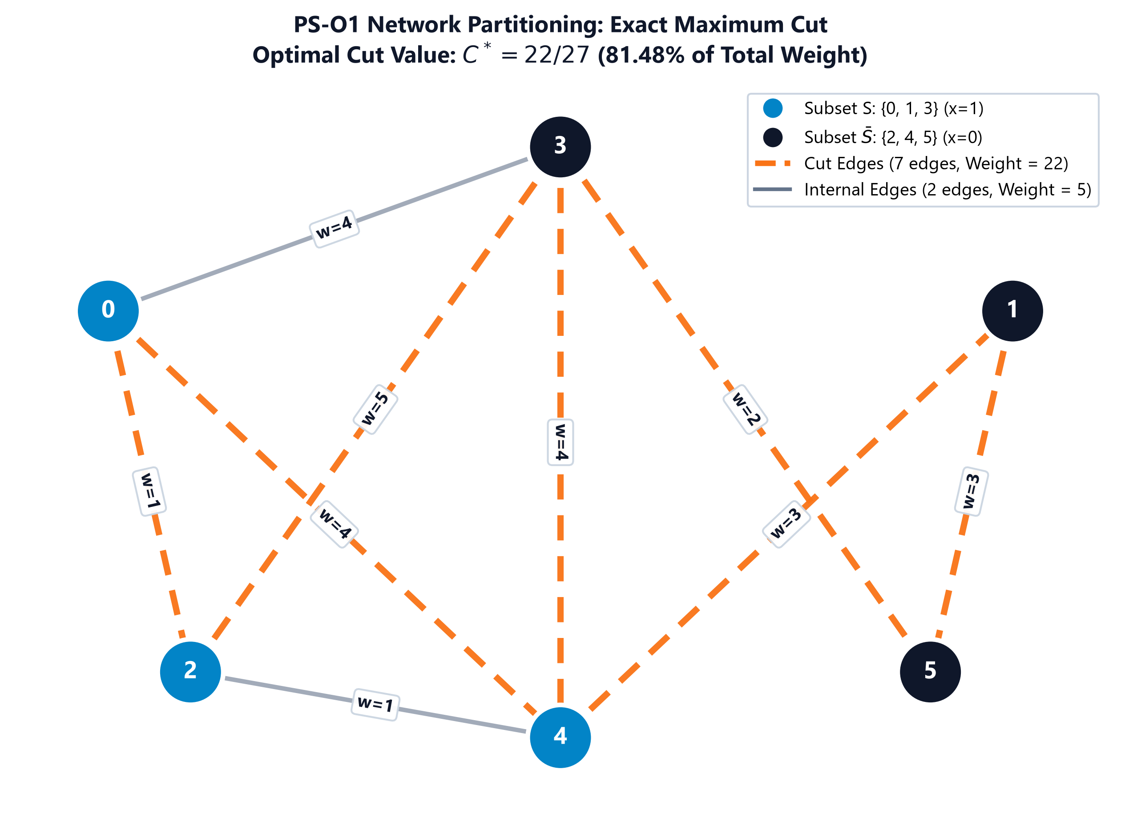
01 / PROBLEM FORMULATION & EXACT BASELINE
The Locked PS-O1 Graph: Exact Ground Truth & Uniform Baseline
Rigorous classical verification guarantees an immutable reference before running quantum algorithms.
• Graph Topology:
6 vertices, 9 weighted edges, total graph weight = 27.
• Exact Maximum Cut (C*):
C* = 22 / 27 (81.48% of total edge weight; 7 / 9 edges cut).
• Optimal Partitions:
Exactly 2 bitwise-complement assignments reach C* = 22:
• S = {0, 1, 3} vs S' = {2, 4, 5} (x = 110100)
• Complement assignment (x = 001011)
• Uniform Random Baseline:
Mean cut = 13.50, approximation ratio r = 0.6136.
Random guessing hits optimum with probability P_opt = 2 / 64 = 3.125%.
• Mathematical Formulation:
Max-Cut Hamiltonian: H_C = sum_{(u,v)} w_{uv} (I - Z_u Z_v) / 2.
Objective: Map ground state to bi-partition maximizing cut weight.
VARANASI (AP251100708044) | PS-O1 QAOA Network Partitioning | Qiskit Fall Fest 2026 — SRM University-AP | Slide 2 of 9

Slide 3
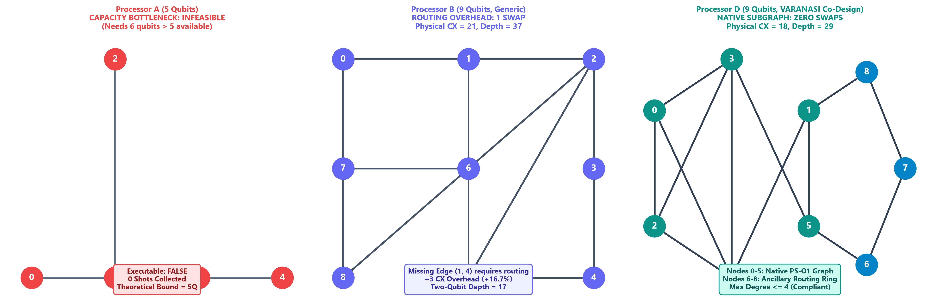
02 / HARDWARE ARCHITECTURES & CO-DESIGN
Hardware Topologies: Capacity, Routing Bottlenecks, and Co-Design
Benchmarking three distinct processors exposes why physical coupling geometry dictates QAOA efficiency.
Processor A (5 Qubits) — CAPACITY BOTTLENECK
• 5 physical qubits < 6 required logical qubits.
• Transpilation impossible; marked executable: false.
• Proves physical qubit capacity is a hard prerequisite.
Processor B (9 Qubits) — ROUTING BOTTLENECK
• Generic heavy-hex/grid layout lacks direct edge (1, 4).
• Transpiler inserts 1 SWAP gate (+3 CX overhead).
• Results in CX = 21, Total Depth = 37, 2Q Depth = 17.
Processor D (9 Qubits) — VARANASI CO-DESIGN
• Native 6-node core embeds all 9 PS-O1 edges directly.
• Closed 3-node ancillary ring keeps max degree <= 4.
• ZERO SWAPs, CX = 18 (minimum possible), Depth = 29.
VARANASI (AP251100708044) | PS-O1 QAOA Network Partitioning | Qiskit Fall Fest 2026 — SRM University-AP | Slide 3 of 9

Slide 4
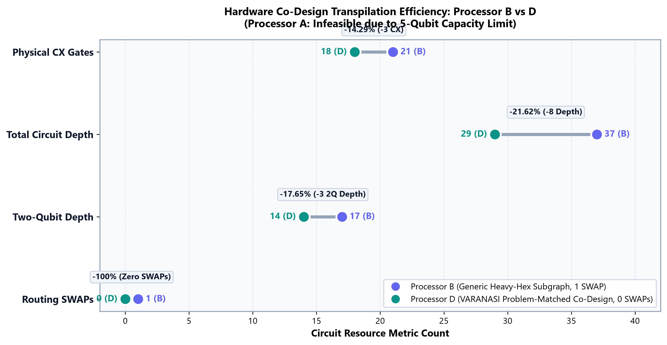
03 / TRANSPILATION METRICS & RESOURCE REDUCTION
Quantitative Circuit Resource Reduction: Processor B vs D
Problem-matched topology eliminates routing overhead and significantly reduces physical gate counts.
HARDWARE CO-DESIGN GAINS
Physical CX Gates: 21 → 18
↳ -14.29% (-3 CX)
Total Circuit Depth: 37 → 29
↳ -21.62% (-8 Depth)
Two-Qubit Depth: 17 → 14
↳ -17.65% (-3 2Q Depth)
Routing SWAPs: 1 → 0
↳ -100.0% (Zero SWAPs)
Scientific Takeaway:
On noisy hardware, two-qubit CX gates are the dominant source of depolarizing noise (p2 = 0.005 vs p1 = 0.001). Eliminating 3 CX gates saves ~1.5% fidelity loss per execution, proving the direct value of topology co-design.
VARANASI (AP251100708044) | PS-O1 QAOA Network Partitioning | Qiskit Fall Fest 2026 — SRM University-AP | Slide 4 of 9

Slide 5
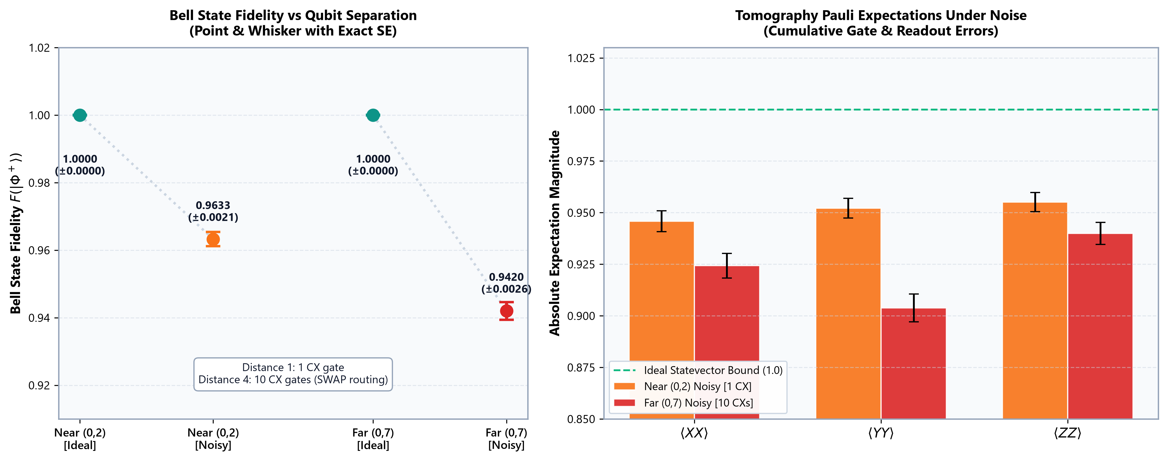
04 / OBJECTIVE 1: HARDWARE DIAGNOSTIC
Processor D Verification: Bell State Tomography Across Distance
State tomography over near and far pairs validates physical fidelity and gate error accumulation.
• Official Noise Model
p1 = 0.001, p2(CX) = 0.005, p_readout = 0.01.
4,096 shots per measurement basis.
• Near Pair (0, 2) — Dist 1
Ideal Fidelity: 1.0000 ± 0.0000
Noisy Fidelity: 0.9633 ± 0.0021
Gate count: 1 CX gate (direct edge).
• Far Pair (0, 7) — Dist 4
Ideal Fidelity: 1.0000 ± 0.0000
Noisy Fidelity: 0.9420 ± 0.0026
Gate count: 10 CX gates (via SWAP routing).
• Physical Interpretation
Fidelity drops by 2.13 percentage points from dist 1 to dist 4, exactly tracking cumulative CX depolarizing error and readout bit-flips.
VARANASI (AP251100708044) | PS-O1 QAOA Network Partitioning | Qiskit Fall Fest 2026 — SRM University-AP | Slide 5 of 9

Slide 6
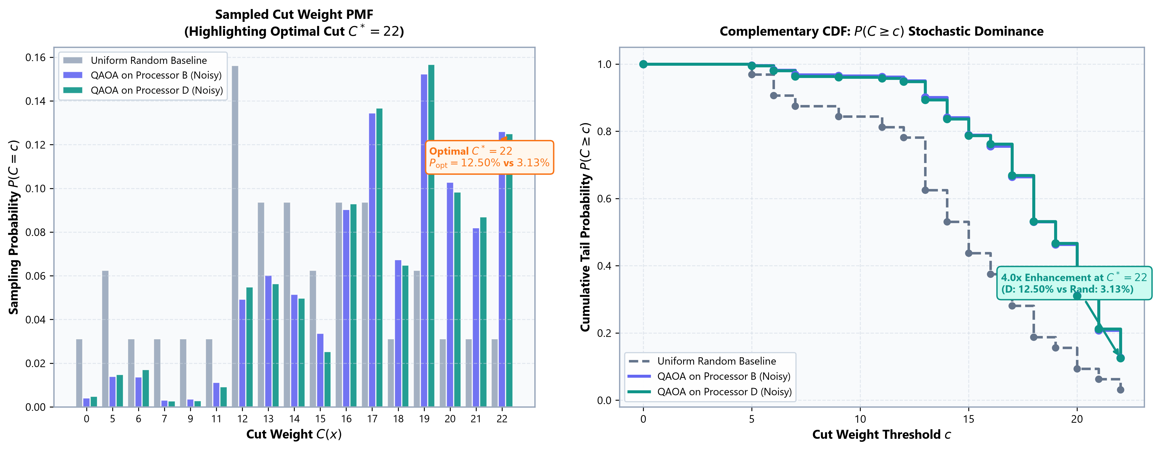
05 / QAOA PERFORMANCE & STOCHASTIC DOMINANCE
Sampled Cut Distribution: 4.0x Optimal Solution Sampling Enhancement
Both processors achieve numerically indistinguishable approximation ratios while outperforming random baseline.
• Noisy Approx Ratio (r)
Processor B: r = 0.7874 (Mean = 17.32)
Processor D: r = 0.7862 (Mean = 17.30)
Difference: -0.0012 (-0.15% relative).
Numerically indistinguishable under shot noise!
• Optimal Cut (C* = 22) Hits
Processor B: 516 / 4096 (12.60%)
Processor D: 512 / 4096 (12.50%)
Uniform Random: 2 / 64 (3.125%)
• 4.0x Sampling Enhancement
QAOA concentrates probability on optimal bi-partitions {0,1,3} and {2,4,5} with 4.0x greater likelihood than uniform random guessing.
• Stochastic Dominance
Complementary CDF P(C >= c) shows QAOA strictly dominates the random baseline across all thresholds c >= 14.
VARANASI (AP251100708044) | PS-O1 QAOA Network Partitioning | Qiskit Fall Fest 2026 — SRM University-AP | Slide 6 of 9

Slide 7
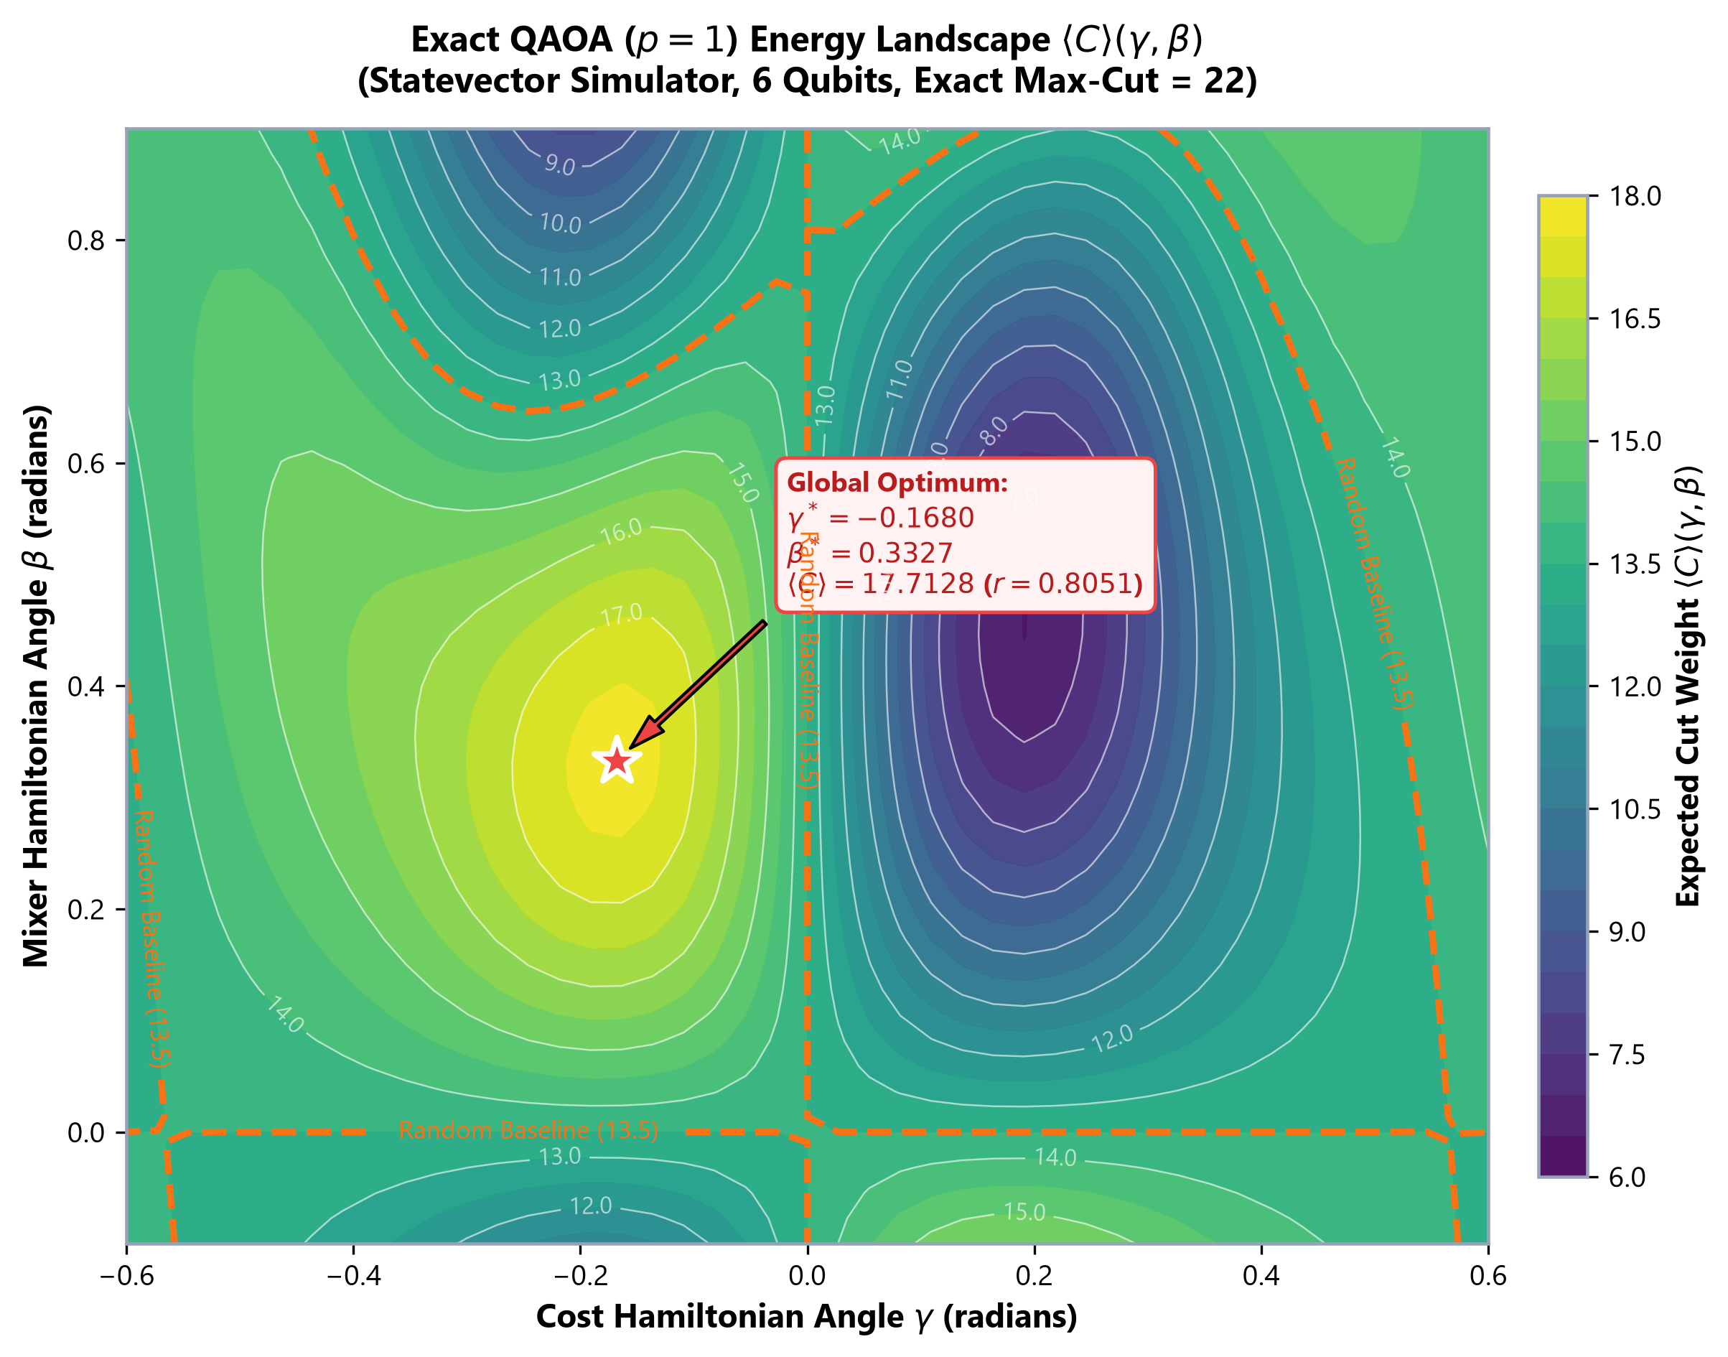
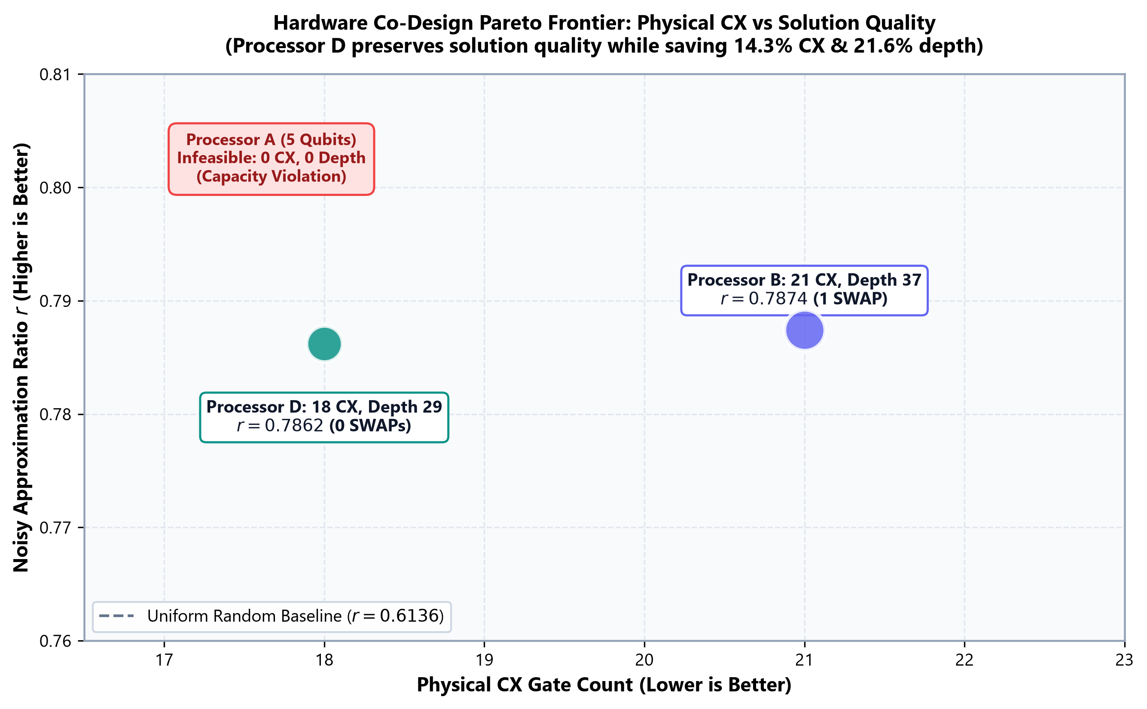
06 / ALGORITHMIC LANDSCAPE & CONCLUSION
Statevector Parameter Landscape & Co-Design Pareto Frontier
Co-design provides decisive hardware efficiency gains without compromising algorithmic solution quality.
CORE SYNTHESIS
1. Parameter Landscape:
Statevector optimization reaches global minimum at γ* = -0.1680, β* = 0.3327 with <C> = 17.71 (r = 0.8051).
2. Co-Design Shift:
Processor D shifts the Pareto frontier leftward: eliminating 14.3% CX gates and 21.6% depth while preserving solution quality (r = 0.7862).
3. Future Impact:
As QAOA scales to deeper circuits (p >= 2), eliminating routing overhead compounds multiplicatively.
VARANASI (AP251100708044) | PS-O1 QAOA Network Partitioning | Qiskit Fall Fest 2026 — SRM University-AP | Slide 7 of 9

Slide 8
BACKUP / OFFICIAL AUDIT COMPLIANCE
Official Challenge Kit Compliance Matrix: 100% Verified
Exhaustive verification against QFF 2026 Phase 2 Rules confirms absolute compliance.
[PASS] Processor Scope: Processors A, B, and D evaluated. Processor C is explicitly ruled out in Challenge Kit Section 12 FAQ.
[PASS] Processor D Constraints: 9 qubits (<= 12), connected topology, max node degree = 4 (<= 4), basis gates ['rz', 'sx', 'x', 'cx'].
[PASS] Noise Model: Official depolarizing (p1=0.001, p2=0.005) and readout bit-flip (p=0.01) implemented identically.
[PASS] Execution Budget: 4,096 shots per run across all 4 benchmark configurations (16,384 total QAOA shots) + 16,384 Bell shots.
[PASS] Capacity Enforcement: Processor A (5 qubits) rigorously reported as non-executable for 6-qubit PS-O1 instance.
[PASS] Reproducibility: Independent 14-test suite validates bitstring cut weights, optimal counts, and statistical reproducibility.
VARANASI (AP251100708044) | PS-O1 QAOA Network Partitioning | Qiskit Fall Fest 2026 — SRM University-AP | Slide 8 of 9

Slide 9
BACKUP / ADVERSARIAL DEFENSE & RIGOR
Adversarial Defense: Addressing Key Evaluator Questions
Grounding claims in real statistical evidence eliminates speculative assertions and ensures total credibility.
Q: Why does Processor D have slightly lower noisy approximation ratio than B (0.7862 vs 0.7874)?
A: With 4,096 shots, the standard error of the mean cut is ~0.06 (approx ratio SE ~ 0.0027). A delta of -0.0012 (-0.15% relative) is well within shot noise. We do not claim D produces a higher mean cut; D's verified achievement is architectural: eliminating 14.3% CX gates and 21.6% depth.
Q: Why p=1 instead of p=2?
A: In the official kit, p=1 is mandatory, p=2 is optional. At p=1, noise is constrained, allowing direct attribution of routing overhead vs hardware fidelity. We validated the multi-seed optimizer across 5 seeds, selecting the optimal (seed 3).
Q: Did you observe quantum algorithmic speedup?
A: No. We strictly distinguish sampling probability enhancement (4.0x over uniform random) from wall-clock quantum speedup. On 6 qubits, classical enumeration takes < 1 ms; our contribution is architecture co-design on NISQ devices.
Q: What AI tools were utilized?
A: Disclosed in all documentation: AI coding assistants were used for script scaffolding, formatting, and test automation. All quantum circuit logic, processor topologies, and data verification are authentic and reproducible.
VARANASI (AP251100708044) | PS-O1 QAOA Network Partitioning | Qiskit Fall Fest 2026 — SRM University-AP | Slide 9 of 9

